Slide 1
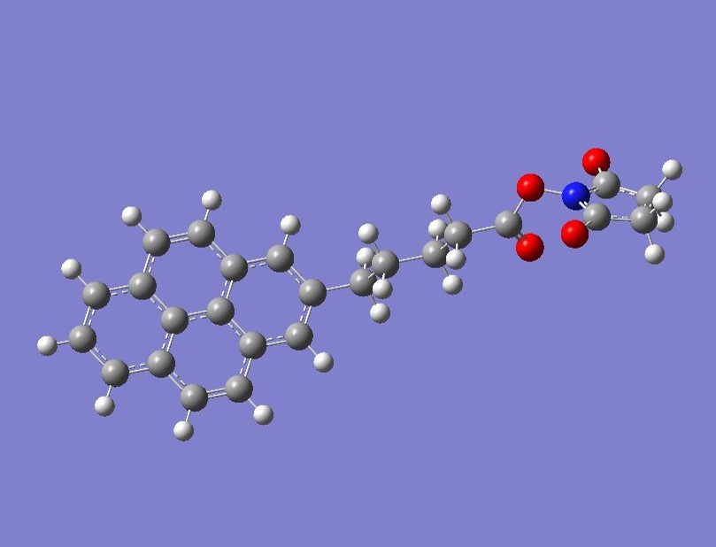
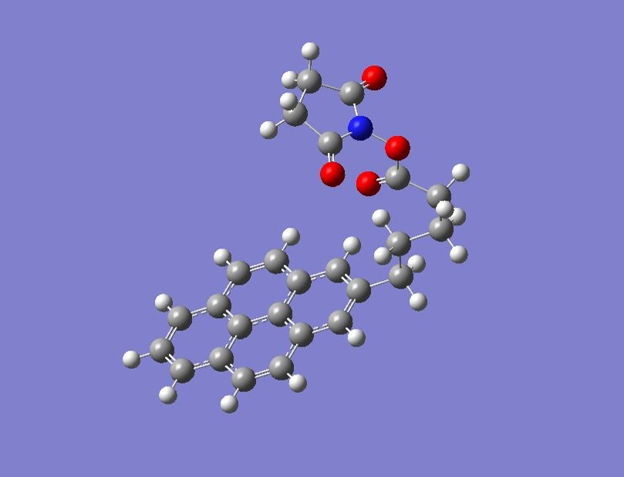

Slide 2
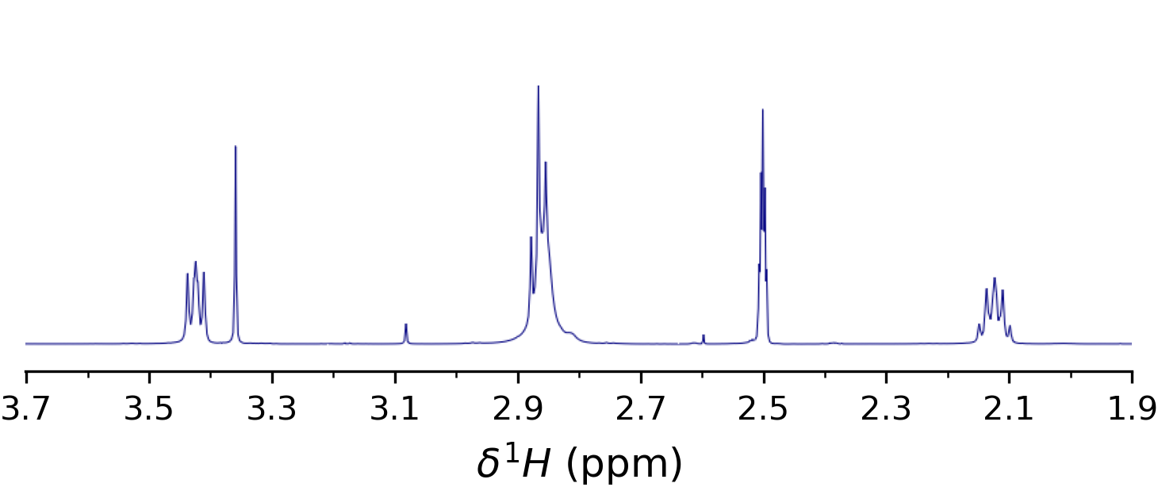
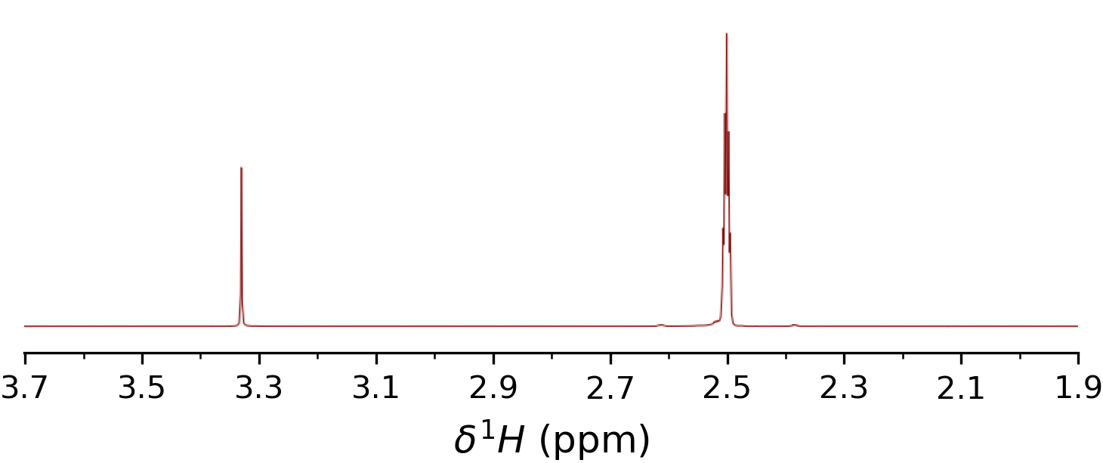
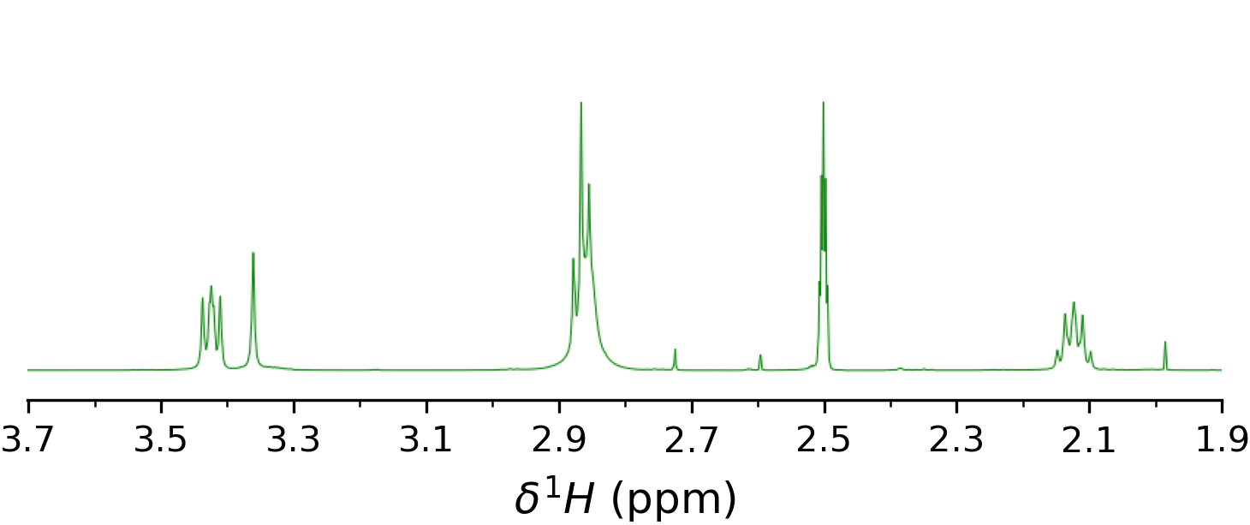
DMSO
H₂O
PBASE
DMSO
PBASE
H₂O
PBASE
PBASE
DMSO
PBASE
H₂O
PBASE

Slide 3
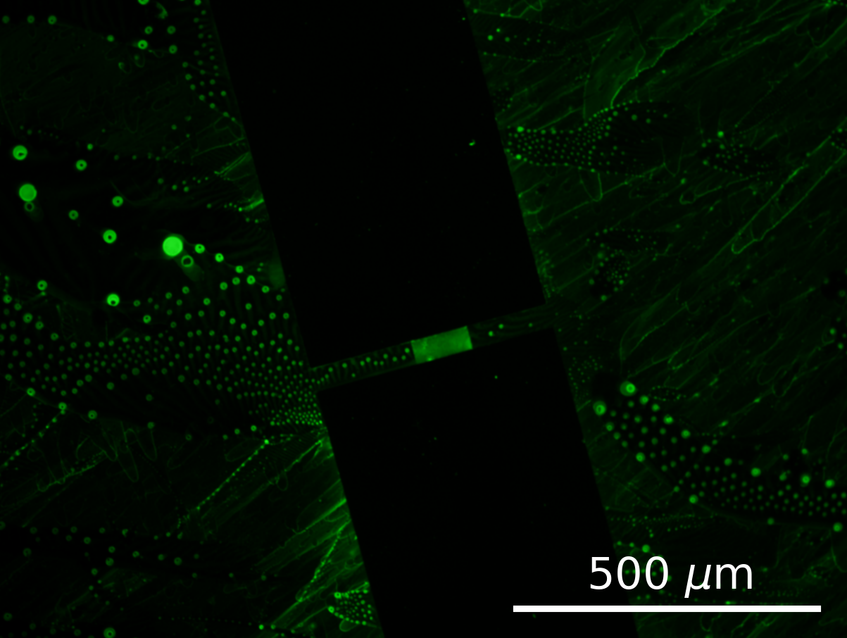
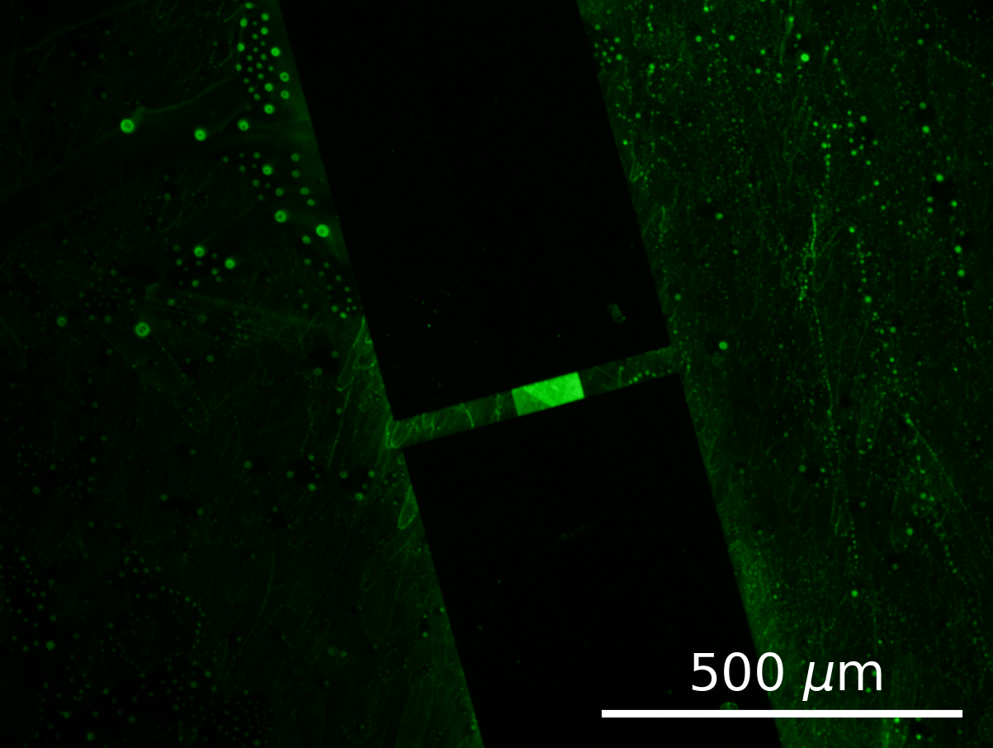
SiO₂
SiO₂
Ti/Au
Ti/Au
Graphene
Graphene
Ti/Au
Ti/Au
SiO₂
SiO₂

Slide 4
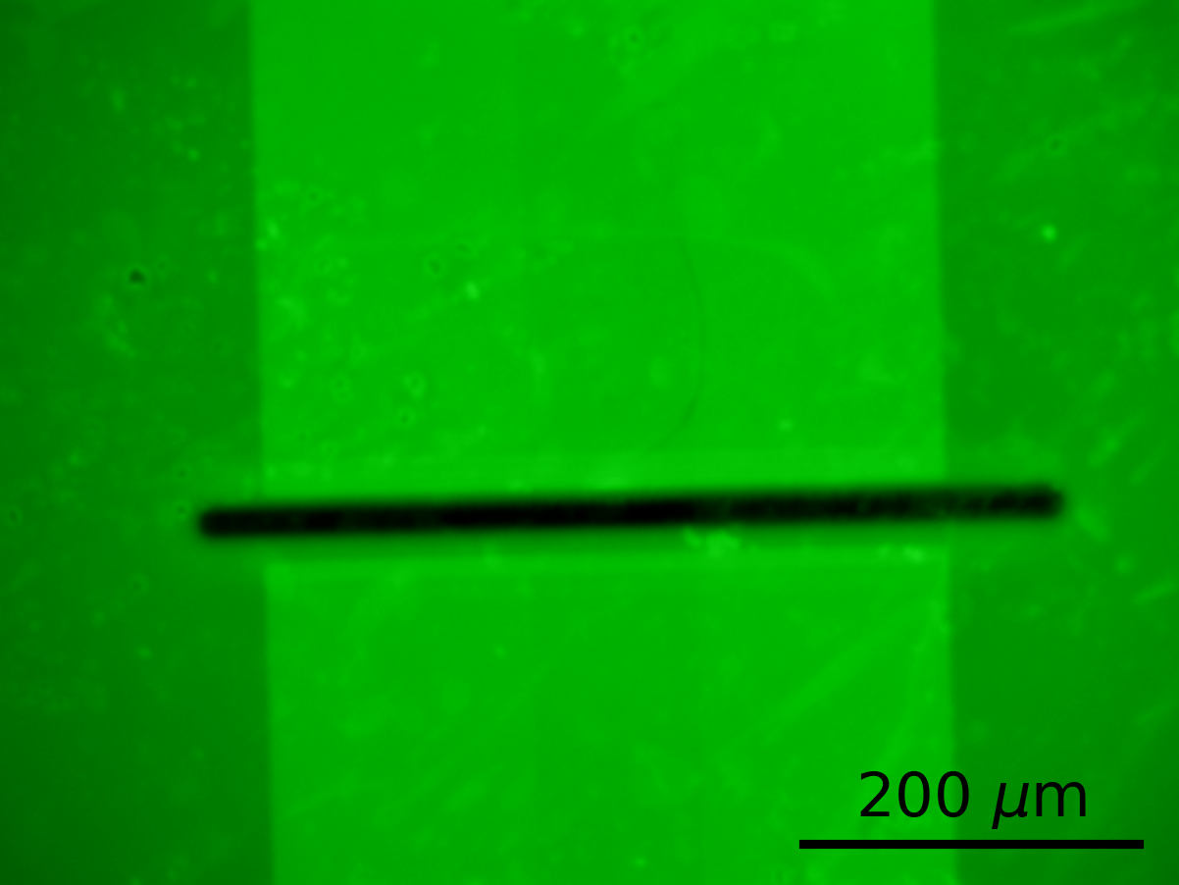
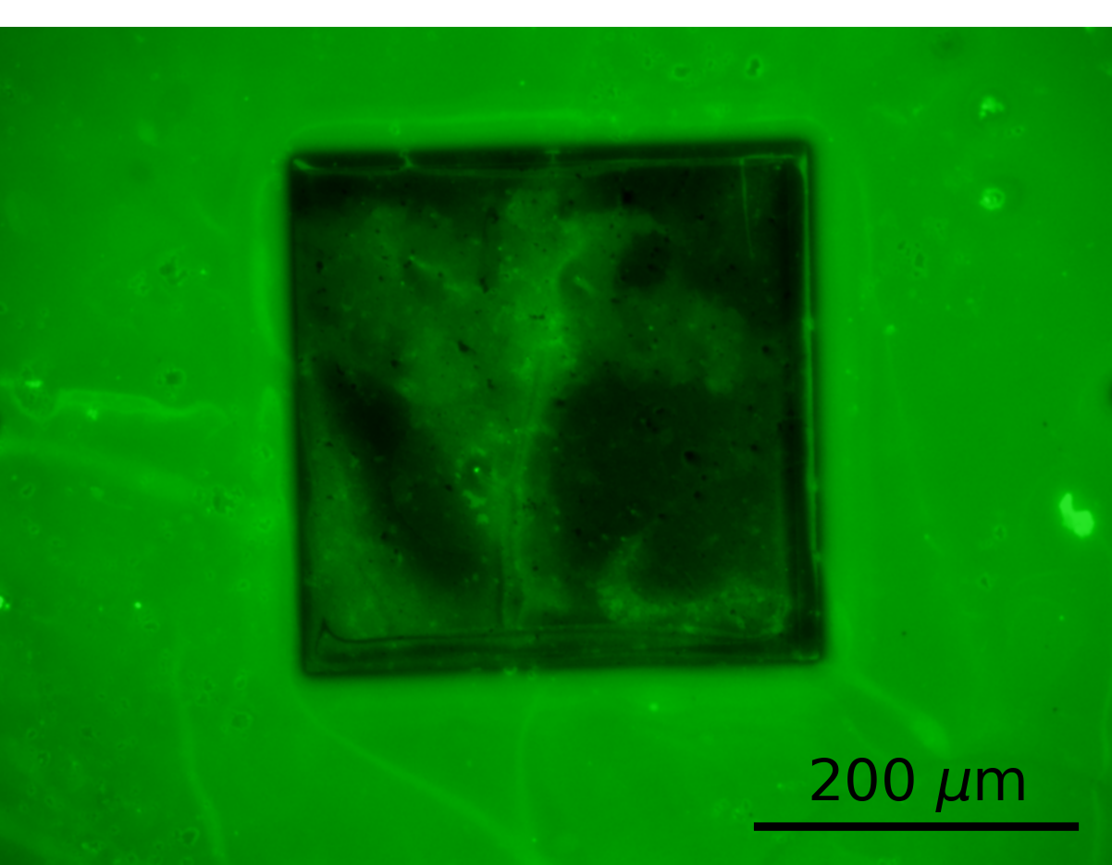
Unencapsulated
region
Cr/Au
CNTs
CNTs
Cr/Au

Slide 5
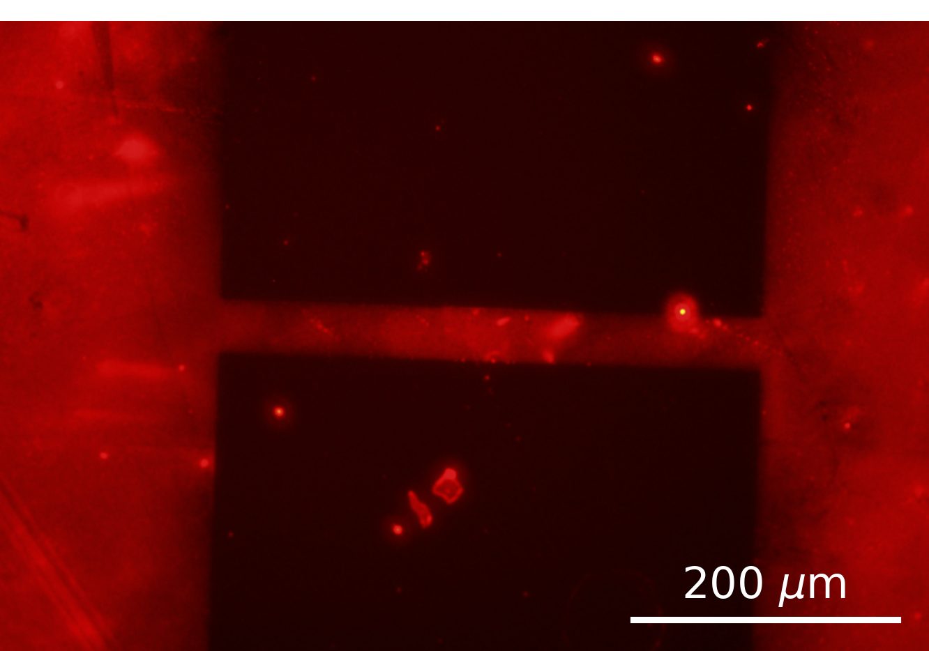
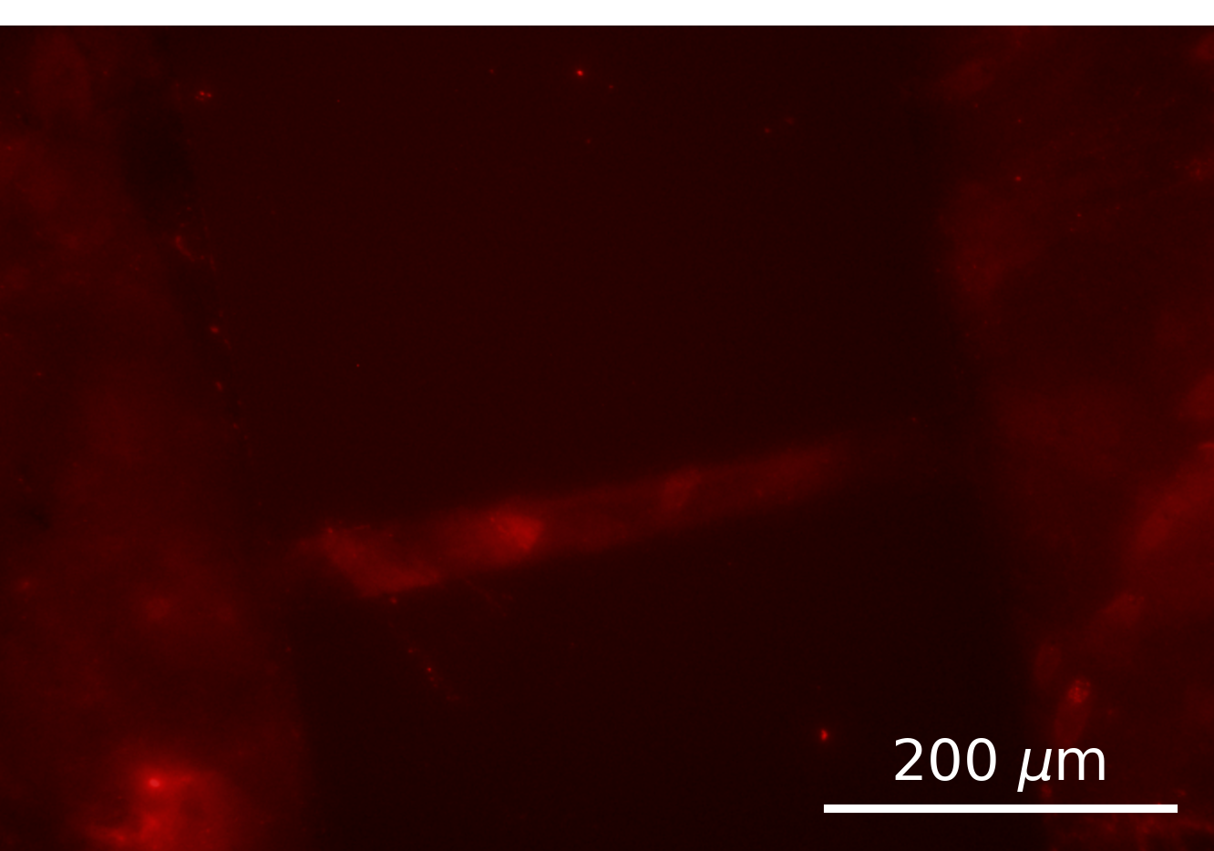
Cr/Au
Cr/Au

